Slide 1
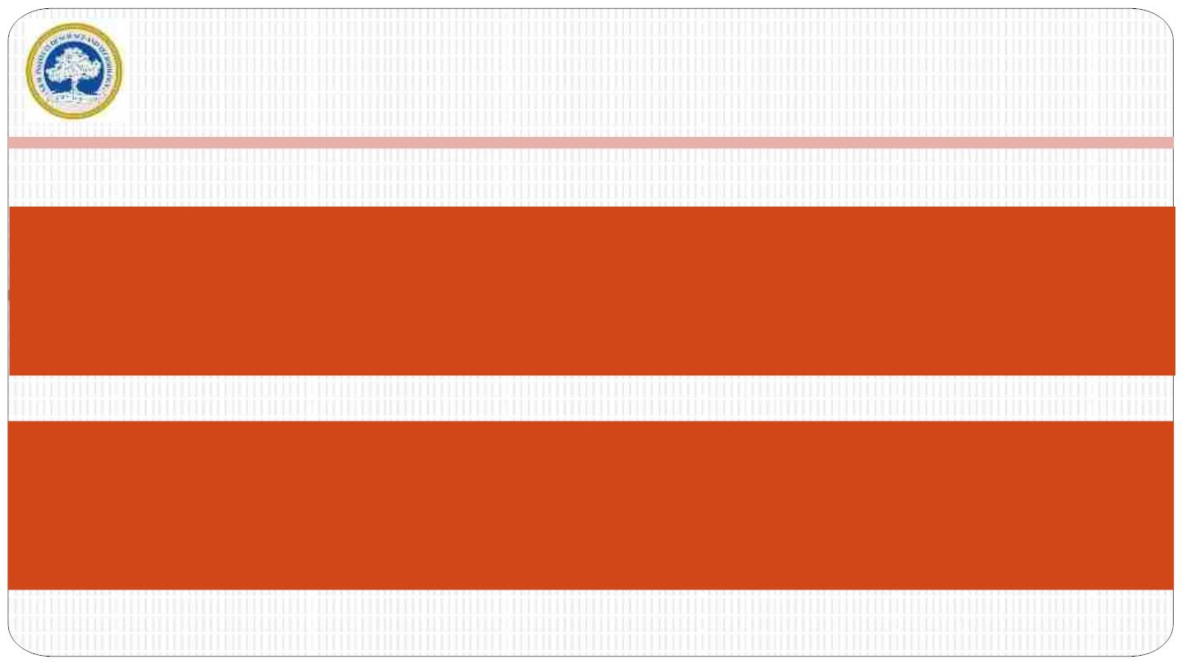
SRM
INSTITUTE OF SCIENCE AND
TECHNOLOGY,
CHENNAI.
Department of Computer Science and
Engineering
21CSS101J – Programming for Problem
Solving Unit IV

Slide 2

SRM INSTITUTE OF SCIENCE AND TECHNOLOGY,
CHENNAI.
UNIT IV
INTRODUCTION
IntroductionꢀtoꢀPythonꢀ-ꢀIntroductionꢀtoꢀGoogleꢀColabꢀ-ꢀBasicꢀDataꢀ
Types:ꢀ Integers,ꢀ Floatingꢀ Points,ꢀ Booleanꢀ typesꢀ -ꢀ Workingꢀ withꢀ
Stringꢀ functionsꢀ -ꢀ Workingꢀwithꢀ Input,ꢀ Outputꢀ functionsꢀ -ꢀ Python-
Singleꢀ andꢀ Multiꢀ lineꢀ Comments/ꢀ Errorꢀ Handlingꢀ -ꢀ Conditionalꢀ &ꢀ
Loopingꢀ Statementsꢀ :ꢀ If,ꢀ for,ꢀwhileꢀ statementsꢀ -ꢀ Workingꢀwithꢀ Listꢀ
structuresꢀ -ꢀ Workingꢀ withꢀ Tuplesꢀ dataꢀ structuresꢀ -ꢀ Workingꢀ withꢀ
Setsꢀ -ꢀ Workingꢀ withꢀ Dictionariesꢀ -ꢀ Introductionꢀ toꢀ Pythonꢀ
Librariesꢀ-ꢀIntroductionꢀtoꢀNumpyꢀ-ꢀHighꢀDimensionalꢀArrays

Slide 3

1.1 Introduction to Python
Python is a widely used general-purpose, high level programming language.
It was created by Guido van Rossum, and released in 1991.
It is used for:
•web development (server-side),
•software development,
•mathematics,
•system scripting.
3

Slide 4
Introduction to Python
What tasks can Python perform?
•Python can be used on a server to create web applications.
•Python can be used alongside software to create workflows.
•Python can connect to database systems. It can also read and modify files.
•Python can be used to handle big data and perform complex mathematics.
•Python can be used for rapid prototyping, or for production-ready software
development.
4

Slide 5
Introduction to Python
Python Language Features
Interpreted
•There are no separate compilation and execution steps like C and C++.
•Python runs on an interpreter system, meaning that code can be executed as
soon as it is written
Platform Independent
•Python programs can be developed and executed on multiple operating system
platforms.
•Python works on different platforms (Windows, Mac, Linux, Raspberry Pi, etc).
5

Slide 6
Introduction to Python
Python Language Features
•Python has a simple syntax similar to the English language.
•Python has syntax that allows developers to write programs with fewer lines than
some other programming languages.
Rich Library Support
•The Python Standard Library is very vast.
•Known as the “batteries included” philosophy of Python ;It can help do
various things involving regular expressions, documentation generation,
unit testing, threading, databases, web browsers, CGI, email, XML, HTML,
WAV files, cryptography, GUI and many more.
6

Slide 7
Introduction to Python
Python syntax in comparison to other programming languages
•Python was designed for readability, and has some similarities to the English
language with influence from mathematics.
•Python uses new lines to complete a command, as opposed to other
programming languages which often use semicolons or parentheses.
•Python relies on indentation, using whitespace, to define scope; such as the
scope of loops, functions and classes. Other programming languages often use
curly-brackets for this purpose.
7

Slide 8
Introduction to Python
Python syntax
Python syntax can be executed by writing directly in the Command Line:
>>> print("Hello, World!")
Hello, World!
Or by creating a python file on the server, using the .py file extension, and running
it in the Command Line:
C:\Users\Your Name>python myfile.py
8

Slide 9
Sample Program
n1=input(‘Enter Number1’)
n2=input(‘Enter Number2’)
if n1>n2:
print(‘n1 is greater’)
else:
print(‘n1 is greater’)

Slide 10
Introduction to Python
Python syntax
Python Indentation: Indentation refers to the spaces at the beginning of a code line.
Where in other programming languages the indentation in code is for readability only,
the indentation in Python is very important.
Python uses indentation to indicate a block of code.
Example
if 5 > 2:
print("Five is greater than two!")
Python will give you an error if you skip the indentation:
Example
Syntax Error:
if 5 > 2:
print("Five is greater than two!")
10

Slide 11
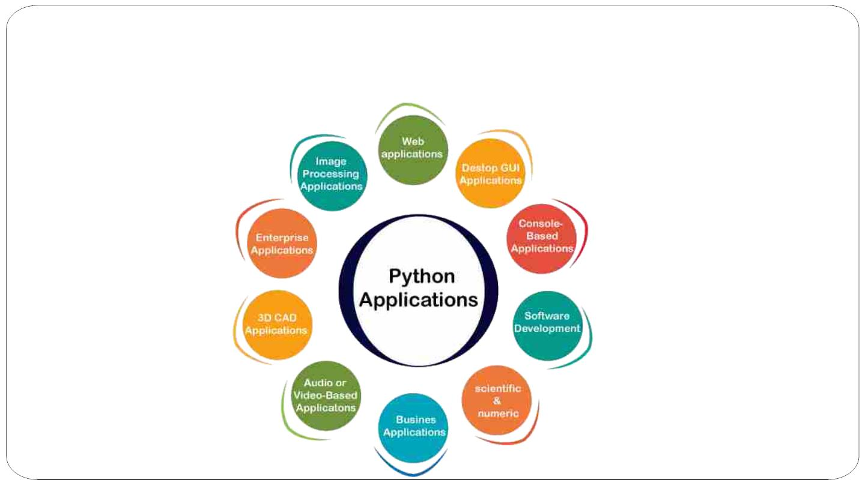
Introduction to Python
Python Applications
11

Slide 12
1.2 Introduction to Google Colab
Google developed AI framework called TensorFlow and a development tool called Colaboratory. Today TensorFlow is open-sourced and since 2017, Google made Colaboratory free for public use. Colaboratory is now known as Google Colab or simply Colab.
Another attractive feature that Google offers to the developers is the use of GPU. Colab supports GPU and it is totally free. It may also have a long term perspective of building a customer base for Google Cloud APIs which are sold per-use basis.
Irrespective of the reasons, the introduction of Colab has eased the learning and development of machine learning applications.

Slide 13
Introduction to Google Colab
Google Colab is a document that allows you to write, run, and share
Python code within your browser. It is a version of the popular Jupyter Notebook within the Google suite of tools.
Jupyter Notebooks (and therefore Google Colab) allow you to create a
document containing executable code along with text, images, HTML, LaTeX, etc. which is then stored in your google drive and shareable to peers and colleagues for editing, commenting, and viewing.

Slide 14
Introduction to Google Colab
What Can You Get From Colab?
Write and execute code in Python
Document your code that supports mathematical equations
Create/Upload/Share notebooks
Import/Save notebooks from/to Google Drive
Import/Publish notebooks from GitHub
Import external datasets e.g. from Kaggle
Integrate PyTorch, TensorFlow, Keras, OpenCV
Free Cloud service with free GPU
4

Slide 15
to Google Colab
SItnarttirnog adduoccutmioennt
As Colab implicitly uses Google Drive for storing your notebooks, ensure
that you are logged in to your Google Drive account before proceeding further.
In order to create a new document, access Google Colab at colab.research.google.com. Once here, you can begin a new document, or “notebook,” in one of two ways. Upon visiting the site, a box with your recently visited Colab documents will appear. Select “New Notebook” to begin a new document. Alternatively, to create a new document from any screen, select “File” in the top left corner, then select “New Notebook” from ₅

Slide 16
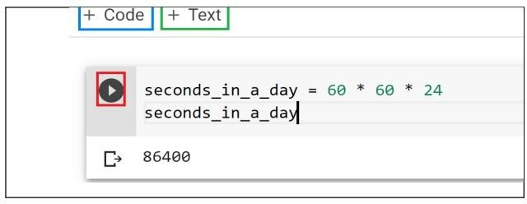
Introduction to Google Colab
Basic Functions
After you have created a new notebook, you will see an empty code cell. Python code can be entered into these code cells and executed at any time by either clicking the Play button to the left of the code cell or by Pressing Command/Ctrl+Enter. On your keyboard..
At the top of your notebook, you will find two buttons: +Code and +Text

Slide 17
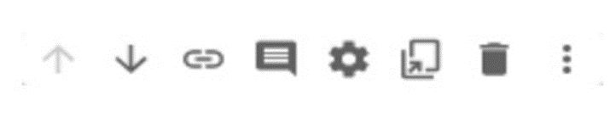
Introduction to Google Colab
Add a new code cell by clicking the “+ Code” button in the top left corner of the document. Add a text cell by clicking the “+ Text” button in the top left corner of the document.
When a cell is selected, a toolbar will appear in the top right corner of the cell. This toolbar contains functions specific to that cell. Options include moving the cell up and down, adding comments, and deleting the cell.

Slide 18

Introduction to Google Colab
Sharing a Colab notebook
As with other Google Apps, Colab Notebooks can be shared. Look for
the “share” button in the top right-hand corner of the window. Google Colab documents can also be shared in Google Drive, just you do with
other types of documents.

Slide 19
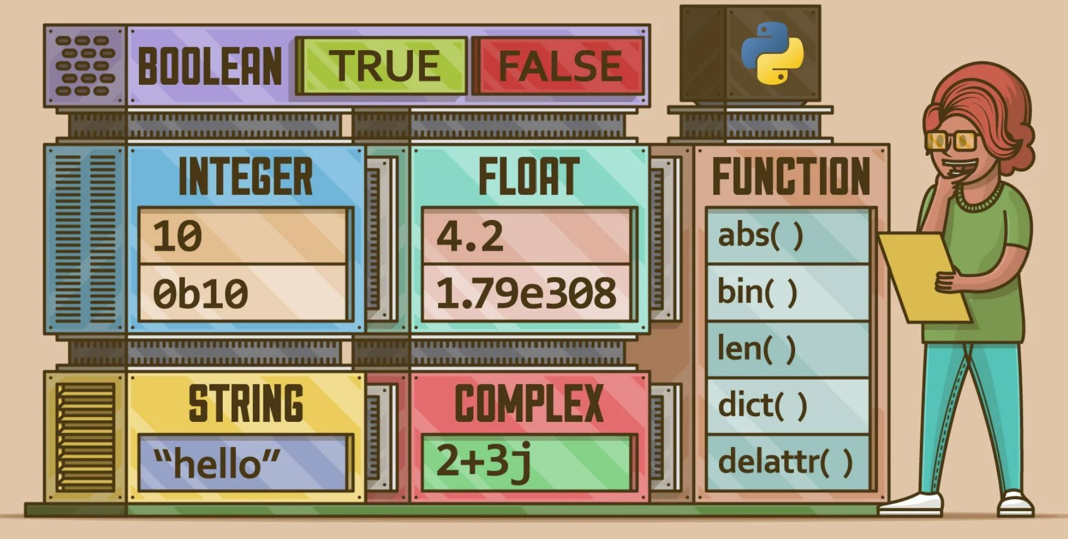
2.1 Basic Data Types in Python

Slide 20
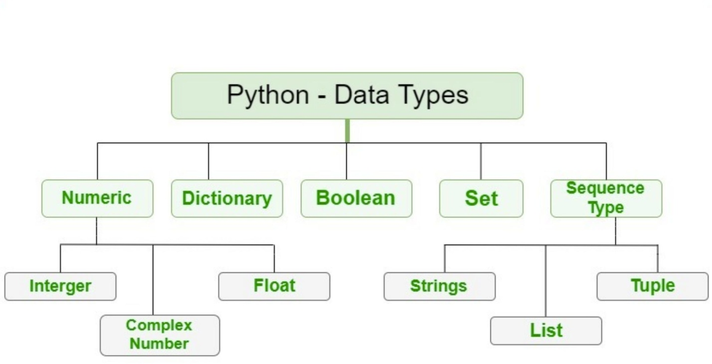
Data types are the classification or categorization of data items.
It represents the kind of value that tells what operations can be performed on a particular data.
Since everything is an object in Python programming, data types are actually classes and variables are instance (object) of these classes.
Following are the standard or built-in data type of Python:

Slide 21
Numeric
In Python, numeric data type represent the data which has numeric value. Numeric value can be integer, floating number or even complex numbers. These values are defined as int, float and complex class in Python.
Integers – This value is represented by int class. It contains positive or negative whole
numbers (without fraction or decimal). In Python there is no limit to how long an integer value can be.
Float – This value is represented by float class. It is a real number with floating point
representation. It is specified by a decimal point. Optionally, the character e or E followed by a positive or negative integer may be appended to specify scientific notation.
Complex Numbers – Complex number is represented by complex class. It is specified as (real part) + (imaginary part)j. For example – 2+3j

Slide 22
# Python program to
# demonstrate numeric value
a = 5
print("Type of a: ", type(a))
b = 5.0
print("\nType of b: ", type(b))
c = 2 + 4j
print("\nType of c: ", type(c))
Output:
Type of a: <class 'int’> Type of b: <class 'float’> Type of c: <class 'complex'>

Slide 23
Boolean
Data type with one of the two built-in values, True or False.
Boolean objects that are equal to True are truthy (true), and those equal to False are falsy (false).
But non-Boolean objects can be evaluated in Boolean context as well and determined to be true or false.
It is denoted by the class bool.
Note – True and False with capital ‘T’ and ‘F’ are valid booleans otherwise python will throw an error.

Slide 24
# Python program to illustrate # built-in method bool()
# Returns False as x is not equal to y x = 5
y = 10
print(bool(x==y))
# Returns False as x is None x = None
print(bool(x))
# Returns False as x is an empty sequence x = ()
print(bool(x))
# Returns False as x is an empty mapping x = {}
print(bool(x))
# Returns False as x is 0 x = 0.0
print(bool(x))
# Returns True as x is a non empty string x = 'GeeksforGeeks'
print(bool(x))

Slide 25
Output False False False False False True

Slide 26
WRITING PSEUDO CODE AND COMMENTS

Slide 27

SRM INSTITUTE OF SCIENCE AND TECHNOLOGY,
CHENNAI.
1. 4 Writing Pseudocode
Pseudo – Imitation / False
Code – Instructions
Goal: To provide a high level description of the Algorithm
Benefit: Enables programmer to concentrate on Algorithm
Similar to programming code
Description of the Algorithm
No specific Programming language notations
Pseudo Code transformed into actual program code

Slide 28
SRM INSTITUTE OF SCIENCE AND TECHNOLOGY,
CHENNAI.
4 Writing Pseudocode Contd…
  Guidelines for Writing Pseudo Code
    Write only one Statement per line
      Example – Pseudo Code for calculating Salary
        READ name, hourly rate, hours worked, deduction rate
        Gross pay = hourly rate * hours worked
        deduction = gross pay * deduction rate
        net pay = gross pay – deduction
        WRITE name, gross, deduction, net pay

Slide 29
SRM INSTITUTE OF SCIENCE AND TECHNOLOGY,
CHENNAI.
4 Writing Pseudocode Contd…
  Capitalize Initial Keyword
    Keywords to be written in capital letters
    Examples: READ, WRITE, IF, ELSE, WHILE, REPEAT, PRINT
  Indent to show Hierarchy
    Indentation shows the structure boundaries
    Sequence
    Selection
    Looping

Slide 30
SRM INSTITUTE OF SCIENCE AND TECHNOLOGY,
CHENNAI.
1.4 Writing Pseudocode Contd…
  End Multiline structures
    Each structure must end properly
    Example: IF statement must end with ENDIF
  Keep Statements Language independent
    Resist the urge to write Pseudo Code in any programming language

Slide 31
SRM INSTITUTE OF SCIENCE AND TECHNOLOGY,
CHENNAI.
1.4 Writing Pseudocode Contd…
  Advantages
    Easily typed in a Word document
    Easily modified
    Simple to Use and understand
    Implements Structured Concepts
    No special symbols are used
    No specific syntax is used
    Easy to translate into Program

Slide 32
SRM INSTITUTE OF SCIENCE AND TECHNOLOGY,
CHENNAI.
4 Writing Pseudocode Contd…
  Disadvantages
    No accepted Standard
    Cannot be compiled and executed

Slide 33
SRM INSTITUTE OF SCIENCE AND TECHNOLOGY,
CHENNAI.
1. 4 Writing Pseudocode Contd…
Write an Pseudo Code to:
  Add three numbers and Display the result
  Calculate Sum and product of two numbers
  Input examination marks and award grades according to the following criteria:
    > = 80 Distinction
    > = 60 First Class
    > = 50 Second Class
    < 40 Fail

Slide 34
SRM INSTITUTE OF SCIENCE AND TECHNOLOGY,
CHENNAI.
4 Writing Pseudocode Contd…
  Pseudo Code to Add Three Numbers
    Use Variables: sum, num1, num2, num3 of type integer
    ACCEPT num1,num2,num3
    Sum = num1+num2+num3
    Print sum
    End Program

Slide 35
SRM INSTITUTE OF SCIENCE AND TECHNOLOGY,
CHENNAI.
4 Writing Pseudocode Contd…
Calculate Sum and product of two numbers
  Use Variables: sum, product, num1, num2 of type real
  DISPLAY “Input two Numbers”
  ACCEPT num1,num2
  Sum = num1+num2
  Print “The sum is”, sum
  product = num1*num2
  Print “The product is”, product
  End Program

Slide 36
SRM INSTITUTE OF SCIENCE AND TECHNOLOGY,
CHENNAI.
4 Writing Pseudocode Contd…
  Input examination marks and award grades
    Use Variables: mark of type integer
    If mark >=80 DISPLAY “Distinction”
    If mark >=60 and mark <80 DISPLAY “First Class”
    If mark >=50 and mark <60 DISPLAY “Second Class”
    If mark <50 DISPLAY “Fail”
    End Program

Slide 37
1. Single-line Comment in C
A single-line comment in C starts with ( // ) double forward slash. It extends till the end of the line and we don’t need to specify its end.
Syntax of Single Line C Comment
// This is a single line comment
// C program to illustrate
// use of single-line comment
#include <stdio.h>
int main(void)
{
// This is a single-line comment
printf("Welcome to GeeksforGeeks");
return 0;
}

Slide 38
2. Multi-line Comment in C
The Multi-line comment in C starts with a forward slash and asterisk ( /* ) and ends with an asterisk and forward slash ( */ ). Any text between /* and */ is treated as a comment and is ignored by the compiler.
It can apply comments to multiple lines in the program.
Syntax of Multi Line C Comment
/* C program to illustrate
use of
multi-line comment */
#include <stdio.h>
int main(void)
{
/*
This is a
multi-line comment
*/
/*
This comment contains some code which
will not be executed.
printf("Code enclosed in Comment");
*/
printf("Welcome to GeeksforGeeks");
return 0;
}

Slide 39
SRM INSTITUTE OF SCIENCE AND TECHNOLOGY,
CHENNAI.
MULTI-Line Comments | SINGLE-Line Comment
Starts with /* and ends with */ | Starts with //
All Words and Statements written between /* and */ are ignored | Statements after the symbol // upto the end of line are ignored
Comment ends when */ Occures | Comment Ends whenever ENTER is Pressed and New Line Starts
e.g /* Program for Factorial */ | e.g // Program for Fibonacci

Slide 40
3.1 String Functions
You have already seen the operators + and * applied to numeric operands
These two operators can be applied to strings as well.
The + operator concatenates strings.
•>>It>re^{s} t⁼u'r^{f}nºs^{o'}a string consisting of the operands joined together, as shown
>>_{h}>_{er}t_{e}=: 'bar'
>>> u = 'baz'
>>> s + t 'foobar‘
>>> s + t + u 'foobarbaz'
>>> print('Go team' + '!!!') Go team!!!

Slide 41
String Operators
The * operator creates multiple copies of a string.
If s is a string and n is an integer, either of the following expressions returns a string consisting of n concatenated copies of s:
s * n n * s
Example:
>>> s = 'foo.'
>>> s * 4 'foo.foo.foo.foo.'
>>> 4 * s 'foo.foo.foo.foo.'

Slide 42
String Operators
The multiplier operand n must be an integer.
It can even be zero or negative, in which case the result is an empty string:
Example:
>>> 'foo' * -8 ‘ ’

Slide 43
String Operators
The in Operator
Python also provides a membership operator that can be used with strings.
The in operator returns True if the first operand is contained within the second, and False otherwise
>>> s = 'foo'
>>> s in 'That\'s food for thought.' True
>>> s in 'That\'s good for now.' False

Slide 44
String Operators
There is also a not in operator, which does the opposite:
>>> 'z' not in 'abc' True
>>> 'z' not in 'xyz' False

Slide 45
Built-in String Functions
Python provides many functions that are built-in to the interpreter and
always available.
Here are a few that work with strings:
Function Description
chr() Converts an integer to a character ord() Converts a character to an integer len() Returns the length of a string
str() Returns a string representation of an object

Slide 46
Built-in String Functions
ord()
Returns an integer value for the given character.
>>> ord('a') 97
>>> ord('#') 35

Slide 47
Built-in String Functions
chr(n)
chr() does the reverse of ord().
Given a numeric value n, chr(n) returns a string representing the character that corresponds to n.
>>> chr(97) 'a'
>>> chr(35) '#'

Slide 48
Built-in String Functions
len(s)
Returns the length of a string.
With len(), you can check Python string length. len(s) returns the number of characters in s
>>> s = 'I am a string.'
>>> len(s) 14

Slide 49
Built-in String Functions
str(obj)
Virtually any object in Python can be rendered as a string.
str(obj) returns the string representation of object obj
>>> str(49.2) '49.2'
>>> str(3+4j) '(3+4j)'
>>> str(3 + 29) '32'
>>> str('foo') 'foo'

Slide 50
3.2 INPUT AND OUTPUT FUNCTIONS

Slide 51
Input Function
Sometimes a developer might want to take user input at some point in the program.
To do this Python provides an input() function.
Syntax:
  input('prompt')
where prompt is an optional string that is displayed on the string at the time of taking input.
# Taking input from the user
name = input("Enter your name: ")
# Output
print("Hello, " + name) print(type(name))
Enter your name: GFG Hello, GFG
<class 'str'>

Slide 52
Input Function
Note: Python takes all the input as a string input by default.
To convert it to any other data type we have to convert the input explicitly.
For example, to convert the input to int or float we have to use the int() and float() method respectively.
# Taking input from the user as integer num = int(input("Enter a number: ")) add = num + 1
# Output print(add)
Enter a number: 25
26

Slide 53
Input Function
we can take multiple inputs of the same data type at a time in python,
using map() method in python.
a, b, c = map(int, input("Enter the Numbers : ").split()) print("The Numbers are : ",end = " ")
print(a, b, c)
Enter the Numbers : 2 3 4
The Numbers are : 2 3 4

Slide 54
Output Function
Python provides the print() function to display output to the standard output devices.
Syntax:
  print(value(s), sep= ‘ ‘, end = ‘\n’, file=file, flush=flush)
Parameters:
  value(s) : Any value, and as many as you like. Will be converted to string before printed
  sep=’separator’ : (Optional) Specify how to separate the objects, if there is more than one.Default :’ ‘
  end=’end’: (Optional) Specify what to print at the end.Default : ‘\n’
  file : (Optional) An object with a write method. Default :sys.stdout
  flush : (Optional) A Boolean, specifying if the output is flushed (True) or buffered (False). Default: False
  Returns: It returns output to the screen.

Slide 55
Output Function
Example: Python Print Output
# Python program to demonstrate # print() method
print("GFG")
# code for disabling the softspace feature print('G', 'F', 'G')
GFG G F G

Slide 56
Output Function
In the above example, we can see that in the case of the 2nd print statement
there is a space between every letter and the print statement always add a new line character at the end of the string.
This is because after every character the sep parameter is printed and at the end of the string the end parameter is printed.
Let’s try to change this sep and end parameter. # Python program to demonstrate
# print() method print("GFG", end = "@")
# code for disabling the softspace feature print('G', 'F', 'G', sep="#")
GFG@G#F#G

Slide 57
Formatting Output
Using formatted string literals
We can use formatted string literals, by starting a string with f or F before opening quotation marks or triple quotation marks.
In this string, we can write Python expressions between { and } that can refer to a variable or any literal value.
# Declaring a variable name = "Gfg"
# Output
print(f'Hello {name}! How are you?')
Hello Gfg! How are you?

Slide 58
Formatting Output
Using format()
We can also use format() function to format our output to make it look presentable.
The curly braces { } work as placeholders.
We can specify the order in which variables occur in the output.
a = 20
b = 10
sum = a + b # addition
The value of a is 20 and b is 10 30 is the sum of 20 and 10
10 is the subtraction of 20 and 10
sub = a- b # subtraction
print('The value of a is {} and b is {}'.format(a,b)) # Output
print('{2} is the sum of {0} and {1}'.format(a,b,sum))
print('{sub_value} is the subtraction of {value_a} and {value_b}'. format(value_a = a , value_b = b, sub_value = sub))

Slide 59
Formatting Output
Using % Operator
We can use ‘%’ operator. % values are replaced with zero or more value of elements.
The formatting using % is similar to that of ‘printf’ in the C programming language.
%d – integer
%f – float
# Taking input from the user
num = int(input("Enter a value: ")) add = num + 5
# Output
print("The sum is %d" %add)
%s – string
%x – hexadecimal
Enter a value: 50 The sum is 55
%o – octal

Slide 60

4.1 SINGLE AND MULTI-LINE
COMMENDS

Slide 61
Comments in Python
Comments are descriptions that help programmers better
understand the intent and functionality of the program.
They are completely ignored by the Python interpreter.
•
•
Advantages of Using Comments
Using comments in programs makes our code more
understandable. It makes the program more readable
which helps us remember why certain blocks of code were
written.
•
Other than that, comments can also be used to ignore
some code while testing other blocks of code. This offers
a simple way to prevent the execution of some lines or
write a quick pseudo-code for the program.
•

Slide 62
Future Reference - Assume that you have written a program
which contains several hundred lines of code without any
comments. If you open the program after one or two months,
then you will find it challenging to understand your code.
Comments help to understand the code of others - We usually
work in a team structure, where others review the code of one
team member. Also, you might need to work on a feature that
was earlier worked by some other developer.
Code Debugging - Sometimes, we have to check a part of the
code to see whether it's working as expected or not. In this
case, we can comment on the remaining code.

Slide 63
How to write comments in Python?
In Python, any statement which begins with a hash
(#) symbol is a comment.
Ø
Ø
Any code you write after the hash (#) symbol doesn't get
executed.

Slide 64
Types of Comments in Python
Single-Line Comment
Multi-Line Comment
•
•
Single-Line Comment
In Python, we use the hash symbol # to write a single-
line comment.
•
Multi-Line Comment
We can use # at the beginning of each line of comment on
multiple lines.
•
Each line is treated as a single comment and all of them
are ignored.
•

Slide 65
Single-Line Comment
• A single-line comment begins with a hash (#) symbol and is useful in mentioning
that the whole line should be considered as a comment until the end of the line.
Example:
#Defining a variable to store number. n = 50
#Store 50 as value into variable n.
• In the above example program, the first line starts with the hash symbol, so the
entire line is considered a comment.
• In the second line of code, "N = 50" is a statement, and after the statement, the
comment begins with the # symbol. From the # symbol to the end of this line, the
line will be treated as a comment.

Slide 66
Multi-Line Comment
Multi-line comment is useful when we need to comment on
many lines. You can also use a single-line comment, but using
a multi-line instead of single-line comment is easy to comment
on multiple lines.
In Python Triple double quote (""") and single quote (''') are used
for Multi-line commenting. It is used at the beginning and end
of the block to comment on the entire block. Hence it is also
called block comments.
Example:
""" Python program to demonstrate
multiline comments"""
print("Multiline comments")

Slide 67
Python Docstring
• Python Docstring is the string literals with triple quotes that are
appeared right after the function.
• It is used to associate documentation that has been written with
Python modules, functions, classes, and methods.
• It is added right below the functions, modules, or classes to describe
what they do.
• In Python, the docstring is then made available via the __doc__
attribute.
Example:
def multiply(a, b):
"""Multiplies the value of a and b"""
return a*b
# Print the docstring of multiply function
print(multiply.__doc__)

Slide 68
4.2 ERROR HANDLING

Slide 69
Error Handling
Python has many built in exceptions that are raised when your program encounters an error.
When these exceptions occur, the Python interpreter stops the current process and passes it to the calling process until it is handled. If not handled, the program will crash.
For example, let us consider a program where we have a function A that calls function B, which in turn calls
function C. If an exception occurs in function C but is not handled in C, the exception passes to B and then to A.
If never handled, an error message is displayed and our program comes to a sudden unexpected halt.

Slide 70
Difference between Syntax Error and Exceptions
Syntax Error: As the name suggests this error is caused by the wrong syntax in the code. It leads to the termination of the program.
Example:
# initialize the amount variable amount = 10000
# check that You are eligible to
# purchase Dsa Self Paced or not if(amount > 2999)
print("You are eligible to purchase Dsa Self Paced")

Slide 71
Difference between Syntax Error and Exceptions(Contd..)
Exceptions: Exceptions are raised when the program is syntactically correct, but the code resulted in an error. This error does not stop the execution of the program, however, it changes the normal flow of the program.
Example:
# initialize the amount variable marks = 10000
# perform division with 0 a = marks / 0
print(a)
In the above example raised the ZeroDivisionError as we are trying to divide a number by 0.

Slide 72
Try and Except Statement
Try and except statements are used to catch and handle exceptions in Python. Statements that can raise exceptions are kept inside the try clause and the statements that handle the exception are written inside except clause.
Example: Let us try to access the array element whose index is out of bound and handle the corresponding exception.
# Python program to handle simple runtime error
#Python 3
a = [1, 2, 3]
try:
print ("Second element = %d" %(a[1]))
# Throws error since there are only 3 elements in array print ("Fourth element = %d" %(a[3]))
except:
print ("An error occurred")
In the above example, the statements that can cause the error are placed inside the try statement (second print statement in our case). The second print statement tries to access the fourth element of the list which is not there and this throws an exception. This exception is then caught by the except statement.

Slide 73
Catching Specific Exception
A try statement can have more than one except clause, to specify handlers for different exceptions. Please note that at most one handler will be executed. For example, we can add IndexError in the above code.
The general syntax for adding specific exceptions are – try:
# statement(s) except IndexError: # statement(s) except ValueError: # statement(s)

Slide 74
Example Program
# Program to handle multiple errors with one # except statement
# Python 3
def fun(a): if a < 4:
# throws ZeroDivisionError for a = 3 b = a/(a-3)
# throws NameError if a >= 4 print("Value of b = ", b)
try:
fun(3)
fun(5)
# note that braces () are necessary here for # multiple exceptions
except ZeroDivisionError:
print("ZeroDivisionError Occurred and Handled") except NameError:
print("NameError Occurred and Handled")

Slide 75
Try with Else Clause
In python, you can also use the else clause on the try-except block which must be present after all the except clauses. The code enters the else block only if the try clause does not raise an exception.
Example:
# Program to depict else clause with try-except # Python 3
# Function which returns a/b def AbyB(a , b):
try:
c = ((a+b) / (a-b)) except ZeroDivisionError:
print ("a/b result in 0") else:
print (c)
# Driver program to test above function AbyB(2.0, 3.0)
AbyB(3.0, 3.0)
Output:
-5.0
a/b result in 0

Slide 76
Finally Keyword in Python
Python provides a keyword finally, which is always executed after the try and except blocks. The final block always executes after normal termination of try block or after try block terminates due to some exception.
Syntax:
try:
# Some Code.... except:
# optional block
# Handling of exception (if required) else:
# execute if no exception finally: # Some code .....
(always executed)

Slide 77
Example Program
# Python program to demonstrate finally
# No exception Exception raised in try block try:
k = 5//0 # raises divide by zero exception.
print(k)
# handles zerodivision exception except ZeroDivisionError: print("Can't divide by zero") finally:
# this block is always executed
# regardless of exception generation. print('This is always executed') Output:
Can't divide by zero
This is always executed

Slide 78
Raising Exception
The raise statement allows the programmer to force a specific exception to occur. The sole argument in raise indicates the exception to be raised. This must be either an exception instance or an exception class.
Example
# Program to depict Raising Exception try:
raise NameError("Hi there") # Raise Error except NameError:
print ("An exception")
raise # To determine whether the exception was raised or not
The output of the above code will simply line printed as “An exception” but a Runtime error will also occur in the last due to the raise statement in the last line.

Slide 79
5.1 CONDITIONAL STATEMENT

Slide 80
A Structured programming is an important feature of a
programming language which comprises following logical structure:
Conditional Statement
Iteration or Looping Statement

Slide 81
CONDITIONAL CONSTRUCT – if else STATEMENT
Conditional constructs (also known as if statements) provide a way to execute a chosen block of code based on the run-time evaluation of one or more Boolean expressions. In Python, the most general form of a conditional is written as follows:

Slide 82





CONDITIONAL CONSTRUCT – if else STATEMENT
: Colon Must
Syntax:
if first condition: first body
elif second condition: second body
elif third condition: third body
else:
fourth body

Slide 83
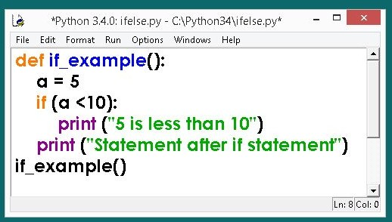


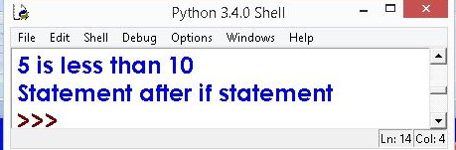
EXAMPLES – if STATEMENT
else is missing, it is an optional statement
OUT PUT

Slide 84
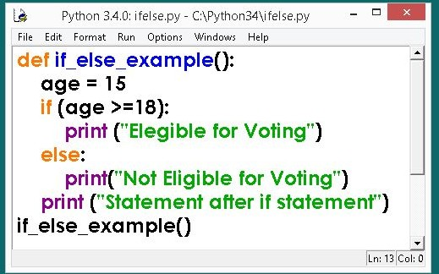





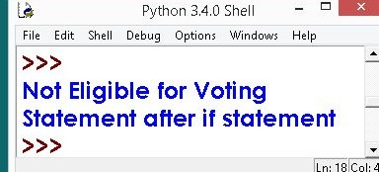
EXAMPLE – if else STATEMENT
: Colon Must
else is used
OUT PUT

Slide 85
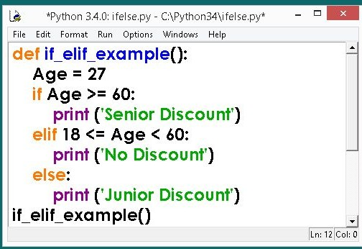


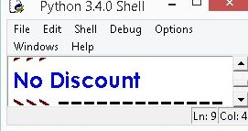
EXAMPLES – if elif STATEMENT
READ AS
18 is less than age and
18 is less
than 60
OUTPUT

Slide 86
5.2 LOOPING STATEMENT

Slide 87


while loop
A while loop allows general repetition based upon the repeated testing of a Boolean condition
The syntax for a while loop in Python is as follows:
while condition: body
: Colon Must
Where, loop body contain the single statement or set of statements (compound statement) or an empty statement.

Slide 88
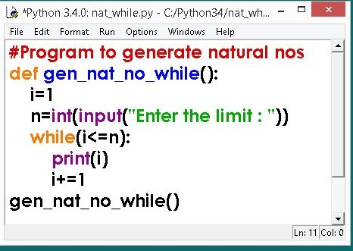
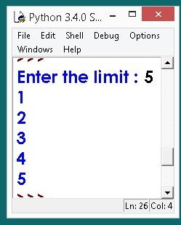




while loop - programs
# Natural Numbers generation
OUTPUT

Slide 89
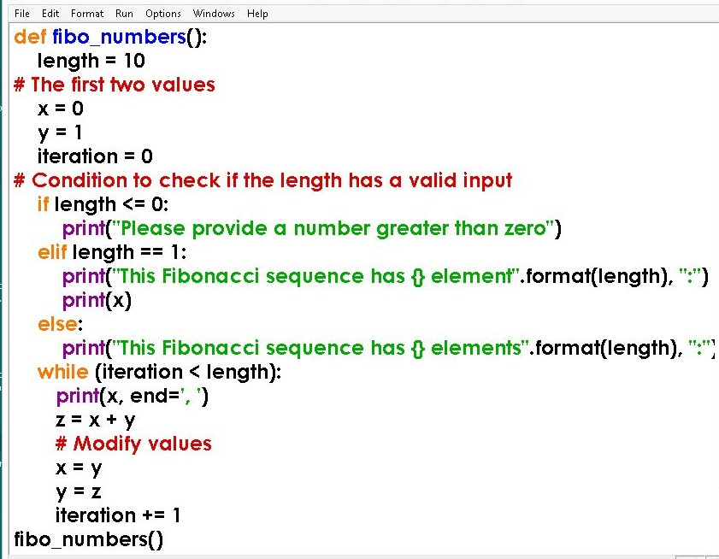

while loop - programs
#Generating Fibonacci numbers

Slide 90
for LOOP
Python’s for-loop syntax is a more convenient alternative to a while loop when iterating through a series of elements. The for-loop syntax
can be used on any type of iterable structure, such as a list, tuple str, set, dict, or file
Syntax or general format of for loop is,
for element in iterable: body

Slide 91
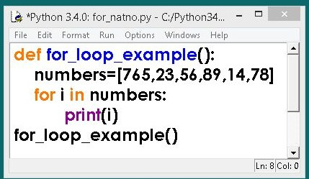
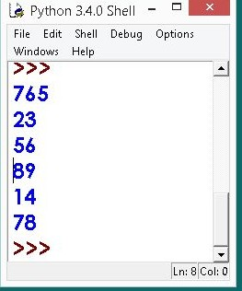




for LOOP
Till the list exhaust for loop will continue to execute
OUTPUT

Slide 92




The range() function returns a sequence of numbers, starting from 0 by default, and increments by 1 (by default), and ends at a specified number.
for LOOP - range KEYWORD
range(start, stop, step)
x = range(3, 6)
for n in range(3,6): print(n)
OR
for n in x: print(n)

Slide 93
6.1 LISTS

Slide 94
Lists
Lists is a built-in data type in python to store values.
Lists is Represented in [].
Lists index starts from [0].
Lists can be created to store different data types .i.e. a list can store different data type values such as float, integer, Boolean, string.
Example of a python program is given below:
List = [1,”idly”,True]
print(List) OP:- [1,”idly”,True]
•
This is a list containing values of different data types such as integer type,
String type and Boolean type.
List items are ordered i.e. they are having a defined order and new items are added to the end of list.
Items are changeable i.e. after creating list, we can add, remove or change particular items in the list, and it allows to store duplicate values.
Ex: List = [1,1] duplicate values
Print(List)
// Here it stores both the values as it allows
// Prints [1,1]

Slide 95
List Methods
1.List.sort():- Here it updates the list items in ascending order.
Ex:- list = [9,8,7,3,1]
list.sort() print(list)
OP:- [1,3,7,8,9]
2.List.reverse():- It updates list items in reverse order.
Ex:- list = [9,8,7,5,1]
list.reverse() print(list)
OP:- [1,5,7,8,9]
3.List.append():- It will add new element at the end of list.
Ex:-list = [9,8,7,3,1]
list.append(0) print(list)
OP:- [9,8,7,3,1,0]

Slide 96
4.List.insert(3,2):- This method adds element 2 at index 3 of the list.
Ex:- list = [9,8,7,3,1]
list.insert(3,2) print(list)
Op:- [9,8,7,2,3,1]
5.List.pop (2):- This method deletes element at the index 2 and returns the list.
Ex:- list = [9,8,7,3,1]
list.pop(2)
print(list)
Op:- [9,8,3,1]
6.List.remove(7):- This method removes element 7 from the list.
Ex:- list = [9,8,7,3,1]
list.remove(7) print(list)
Op:- [9,8,3,1]

Slide 97
List Slicing
Lists Slicing is same as String slicing.
Just like slicing the required part.
It is used to get part of the string.
Example:- List = [1,2,3,4]
Length of List is 4
Index in the list starts from 0 to (Length-1).
List = name[index_start : index_end]
First index is included in the list and last index is not included in the list.
List[0:3] returns [1,2,3] -> characters from 0 to 3 is printed..
List[1:3] returns [2,3] -> characters from 1 to 3 is printed.
Negative Slicing is done in reverse it starts with -1.

Slide 98
Lists as argUMEnts tO FUnctiOns
Just like other data types, lists can be sent to functions as arguments.
The function must be aware of the fact that a parameter is a list, so it can treat it as a list (use subscripts).
Lists are passed to functions in a different way than other arguments.
Passed by value:
The function can do anything you want with the copies.
The copies are deleted when the function finishes and returns. This is called 'passing arguments by value‘.

Slide 99
Passing by reference:
Lists are handled differently.
Their address is sent to the function in the place of a parameter.
Using the address (also called the reference) the function can change the elements of the list-in other words, the function is changing the original contents of the original list.
In other words, the list contents can be changed permanently.

Slide 100
6.2 TUPLES

Slide 101
TUpLEs
Tuples is a built-in and immutable data types in python to store values.
Tuples is Represented in ().
Tuple index starts from [0].
A=()
A=(1,)
A=(1,7,2)
Once defined tuple cannot be altered or modified.
Tuple items are ordered, unchangeable, and it allows to store duplicate values.
A tuple can contain different data types such as integers, bolean, string values.

Slide 102
Tuple Methods
Tuple.count(1):- It returns number of times element 1 occurs in the tuple.
Ex:- tuple = (1,5,1,4) OP:- 2
print(tuple.count(1))
Tuple.index(5):- It returns the index of element 5 in the tuple.
Ex:- tuple = (1,5,1,4) OP:- 1
print(tuple.index(5))
Len():- It determines number of items present in tuple.
Ex:- tuple = (1,5,1,4) OP:- 4
print(len(tuple))

Slide 103
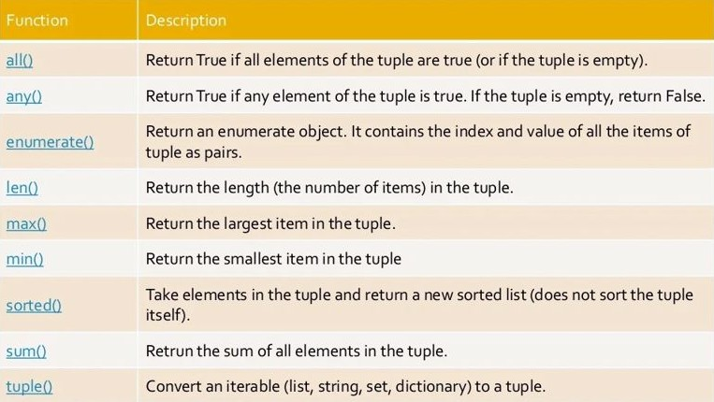
BUILT-IN FUNcTIONs OF TUpLE

Slide 104
7.1 WORKING WITH SETS

Slide 105
Set in Python
A set is an unordered collection of items. Every set element is unique (no duplicates) and must be immutable (cannot be changed). However, a set itself is mutable. We can add or remove items from it. Sets can also be used to perform mathematical set operations like union, intersection, symmetric difference, etc.

Slide 106
Creating Python Sets
A set is created by placing all the items (elements) inside curly braces {}, separated by comma, or by using the built-in set() function. It can have any number of items and they may be of different types (integer, float, tuple, string etc.). But a set cannot have mutable elements like lists, sets or dictionaries as its elements.
my_set = {1, 2, 3} print(my_set)
my_set = {1.0, "Hello", (1, 2, 3)} print(my_set)
Output for the above code snippet
{1, 2, 3}
{1.0, 'Hello', (1, 2, 3)}

Slide 107
Modifying a set in Python
Sets are mutable. However, since they are unordered, indexing has no meaning.
We cannot access or change an element of a set using indexing or slicing.
Set data type does not support it. We can add a single element using the add() method, and multiple elements using the update() method. The update() method can take tuples, lists, strings or other sets as its argument. In all cases, duplicates are avoided.

Slide 108
Modifying a set in Python
my_set = {1, 3} print(my_set) my_set.add(2) print(my_set) my_set.update([2, 3, 4]) print(my_set)
my_set.update([4, 5], {1, 6, 8}) print(my_set)
Output for the above code snippet
{1, 3}
{1, 2, 3}
{1, 2, 3, 4}
{1, 2, 3, 4, 5, 6, 8}
6

Slide 109
Removing elements from a set
A particular item can be removed from a set using the
methods discard() and remove(). The only difference between the two is that the discard() function leaves a set unchanged if the element is not present in the set. On the other hand, the remove() function will raise an error in such a condition (if element is not present in the set).

Slide 110
The following example will illustrate the removing element from the set
my_set = {1, 3, 4, 5, 6} print(my_set) my_set.discard(4) print(my_set) my_set.remove(6) print(my_set) my_set.discard(2) print(my_set) my_set.remove(2)
Output for the above code snippet
{1, 3, 4, 5, 6} {1, 3, 5, 6} {1, 3, 5}{1, 3, 5}KeyError: 2

Slide 111
7.2 Working with Dictionaries

Slide 112
Python Dictionary
Dictionaries are used to store data values in key:value pairs.
It is a collection of changeable and no duplicate elements.
Dictionaries are enclosed by curly braces ({ }) and values can be assigned
and accessed using square braces ([]).
The values in dictionary items can be of any data type such as Text Type,
Numeric Types, Sequence Types, Mapping Type, Set Types, Boolean
Type and Binary Types.
3

Slide 113
Creation of Dictionary
To Create and print a dictionary value use the following code,
sampledict is the name of the dictionary which has the key: value
pair
sampledict = {
"brand": "Ford",
"model": "Mustang",
"year": 1964
}
print(sampledict)
Output for the above code is : {'brand': 'Ford', 'model': 'Mustang',
'year': 2020}
4

Slide 114
Dictionary Items
Dictionaries have no concept of order among elements.
It is incorrect to say that the elements are "out of order"; they
are simply unordered.
Dictionary is a collection which works on a key-value pair.
It works like an associated array where no two keys can be
same. Dictionary items are presented in key:value pairs, and
can be referred to by using the key name.
Dictionaries are changeable, meaning that we can change,
add or remove items after the dictionary has been created.
5

Slide 115
Accessing the Dictionary items
While indexing is used with other data types to access values, a
dictionary uses keys. Keys can be used either inside square
brackets [] or with the get() method
To print the "brand" value of the dictionary use the below code
thisdict = {
"brand": "Ford",
"model": "Mustang",
"year": 1964
}
print(thisdict["brand"])
It prints Ford value for the brand key
6

Slide 116
Accessing the Dictionary items
We use the square brackets [] to access the key
KeyError is raised in case a key is not found in the dictionary.
my_dict = {'name': 'Jack', 'age': 26}
print(my_dict['name'])
print(my_dict.get('age'))
print(my_dict.get('address'))
print(my_dict['address'])
Output:
Jack
26
None
KeyError: 'address'
7

Slide 117
Duplicates are Not Allowed
Dictionaries duplicate keys are allowed with different values, for example
below code snippet there are two keys are having same name called year
with different values. Out shows only one key and its corresponding value.
thisdict = {
"brand": "Ford",
"model": "Mustang",
"year": 1964,
"year": 2020
}
print(thisdict)
output of the above code snippet :
{'brand': 'Ford', 'model': 'Mustang', 'year': 2020}
8

Slide 118
Changing and Adding Dictionary
elements
Dictionaries are mutable. We can add new items or change the value of
existing items using an assignment operator. If the key is already present,
then the existing value gets updated. In case the key is not present, a new
(key: value) pair is added to the dictionary.
my_dict = {'name': 'Jack', 'age': 26}
my_dict['age'] = 27
print(my_dict)
my_dict['address'] = 'Downtown'
print(my_dict)
Output:
{'name': 'Jack', 'age': 27}
{'name': 'Jack', 'age': 27, 'address': 'Downtown'}
9

Slide 119
Duplicates are Not Allowed
Dictionaries duplicate keys are allowed with different values, for example
below code snippet there are two keys are having same name called year
with different values. Out shows only one key and its corresponding value.
thisdict = {
"brand": "Ford",
"model": "Mustang",
"year": 1964,
"year": 2020
}
print(thisdict)
output of the above code snippet :
{'brand': 'Ford', 'model': 'Mustang', 'year': 2020}
10

Slide 120
Removing elements from Dictionary
We can remove a particular item in a dictionary by using the pop() method.
This method removes an item with the provided key and returns
the value.
The popitem() method can be used to remove and return an arbitrary (key,
value) item pair from the dictionary. All the items can be removed at
once, using the clear() method. We can also use the del keyword to
remove individual items or the entire dictionary itself.
11

Slide 121
8.1 PYTHON LIBRARIES

Slide 122
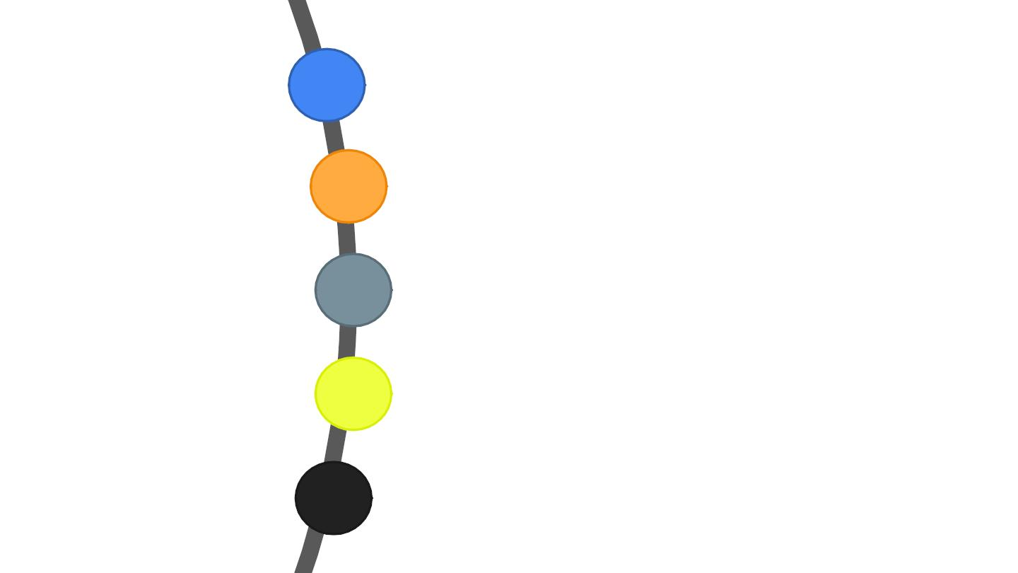
NUMPY
PANDAS
PYTHON
SCIPY & SCIKITLEARN
MATPLOTLIB
LIBRARIES
SEABORN
3

Slide 123

Python Libraries for Data Science
Many popular Python toolboxes/libraries:
All these libraries
are installed on the
SCC
NumPy
SciPy
Pandas
SciKit-Learn
Visualization libraries
matplotlib
Seaborn
and many more …
4

Slide 124
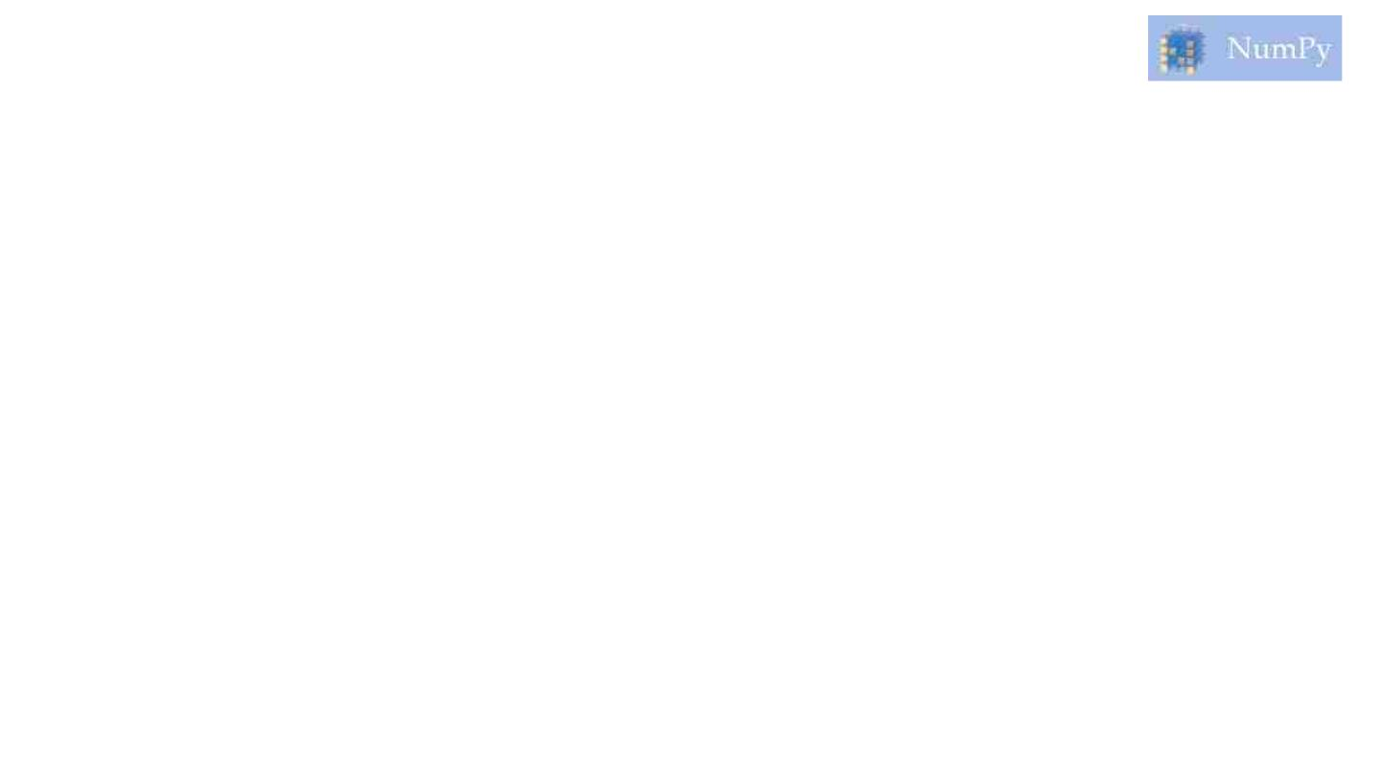
NumPy:
§ NumPy introduces objects for multidimensional arrays and matrices, as well as functions
that allow to easily perform advanced mathematical and statistical operations on those
objects
§ It Provides vectorization of mathematical operations on arrays and matrices which
significantly improves the performance
§ Many other python libraries are built on NumPy
§ The core functionality of NumPy is its "ND array", for n-dimensional array, data structure.
These arrays are stride views on memory.
Link: http://www.numpy.org/
5

Slide 125
Here is some function that are defined in this NumPy Library.
1. zeros (shape [, dtype, order]) - Return a new array of given shape and
type, filled with zeros.
2. array (object [, dtype, copy, order, lubok, ndim]) - Create an array
3. as array (a [, dtype, order]) - Convert the input to an array.
4. As an array (a [, dtype, order]) - Convert the input to an ND array, but
pass ND array subclasses through.
6

Slide 126

SciPy:
§ SciPy is a collection of algorithms for linear algebra, differential equations, numerical
integration, optimization, statistics and more
§ part of SciPy Stack
§ built on NumPy
Link: https://www.scipy.org/scipylib/
7

Slide 127
§ Features Of SciPy:-
§ The main feature of SciPy library is that it is developed using NumPy, and its array
makes the most use of NumPy.
§ In addition, SciPy provides all the efficient numerical routines like optimization, numerical
integration,
and
specific
submodules.
§ Where Is SciPy Used?
§ SciPy is a library that uses NumPy for the purpose of solving mathematical functions.
SciPy uses NumPy arrays as the basic data structure, and comes with modules for
various commonly used tasks in scientific programming.
§ Tasks including linear algebra, integration (calculus), ordinary differential equation
solving and signal processing are handled easily by SciPy.
8

Slide 128
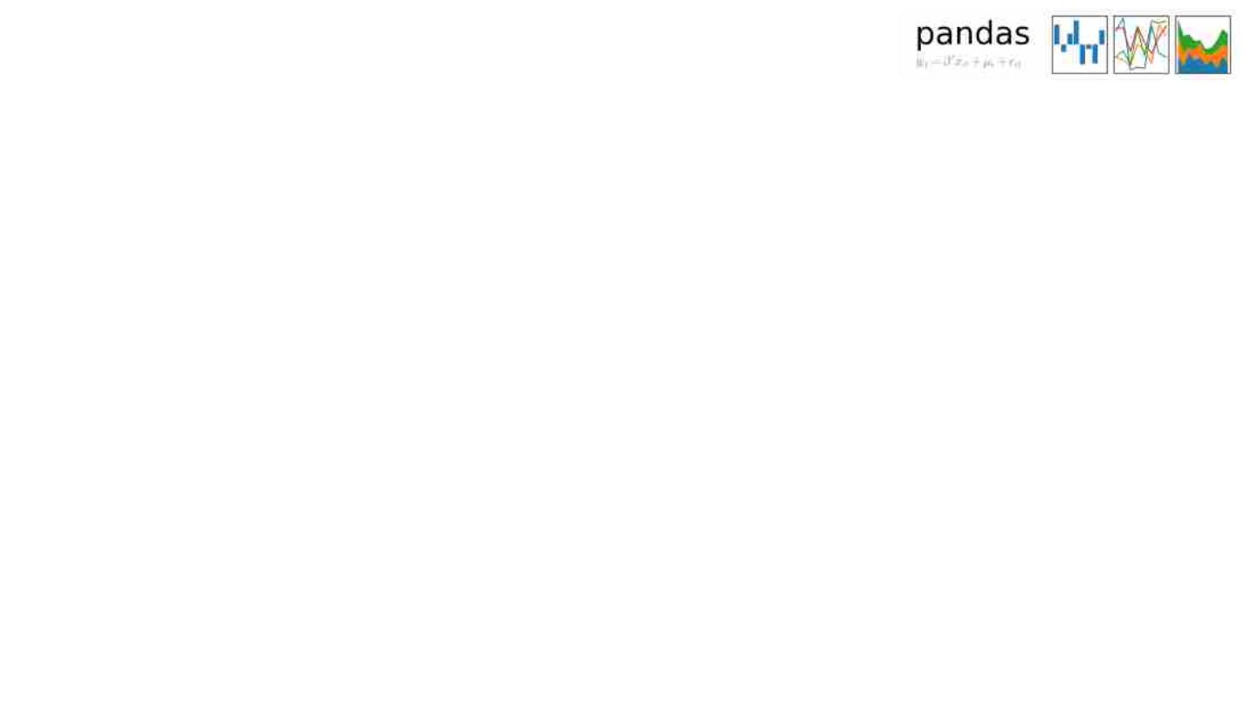
Pandas:
§ adds data structures and tools designed to work with table-like data (similar to Series
and Data Frames in R)
§ provides tools for data manipulation: reshaping, merging, sorting, slicing, aggregation
etc.
§ allows handling missing data
Link: http://pandas.pydata.org/
9

Slide 129
§ Key Features of Pandas
§ Fast and efficient DataFrame object with default and customized
indexing.
§ Tools for loading data into in-memory data objects from different file
formats.
§ Data alignment and integrated handling of missing data.
§ Reshaping and pivoting of date sets.
§ Label-based slicing, indexing and subsetting of large data sets.
§ Columns from a data structure can be deleted or inserted.
§ Group by data for aggregation and transformations.
§ High performance merging and joining of data
10

Slide 130

SciKit-Learn:
§ provides machine learning algorithms: classification, regression, clustering, model
validation etc.
§ built on NumPy, SciPy and matplotlib
Link: http://scikit-learn.org/
11

Slide 131
§ It features various classification, regression and clustering algorithms including support
vector machines, random forests, gradient boosting, k-means and DBSCAN, and is
designed to interoperate with the Python numerical and scientific libraries NumPy and
SciPy.
§ Advantages of using Scikit-Learn:
§ Scikit-learn provides a clean and consistent interface to tons of different models.
§ It provides you with many options for each model, but also chooses sensible defaults.
§ Its documentation is exceptional, and it helps you to understand the models as well as
how to use them properly.
§ It is also actively being developed
12

Slide 132

matplotlib:
§ python 2D plotting library which produces publication quality figures in a variety of
hardcopy formats
§ a set of functionalities similar to those of MATLAB
§ line plots, scatter plots, barcharts, histograms, pie charts etc.
§ relatively low-level; some effort needed to create advanced visualization
Link: https://matplotlib.org/
13

Slide 133
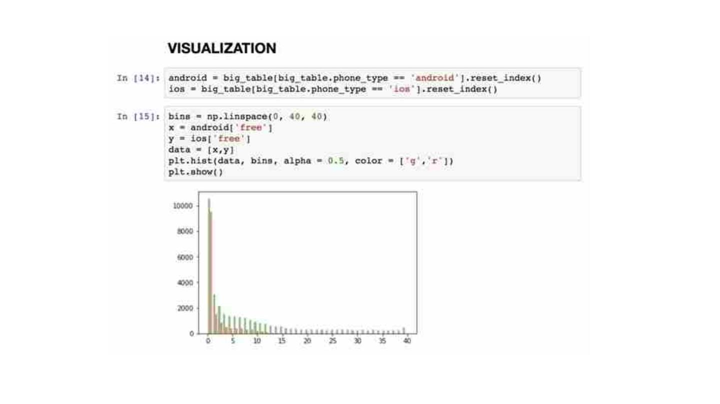
14

Slide 134
Seaborn:
§ based on matplotlib
§ provides high level interface for drawing attractive statistical graphics
§ Similar (in style) to the popular ggplot2 library in R
Link: https://seaborn.pydata.org/
15

Slide 135
§ The main aim of Seaborn is to make visualization a vital part of exploring and
understanding data. Its dataset-oriented plotting functions operate on arrays and data-
frames containing whole datasets. The library is ideal for examining relationships among
multiple variables.
§ Highlights:
§ Automatic estimation as well as the plotting of linear regression models
§ Comfortable views of the overall structure of complex datasets
§ Eases building complex visualizations using high-level abstractions for structuring multi
-plot grids
§ Options for visualizing bivariate or univariate distributions
§ Specialized support for using categorical variables
16

Slide 136

Loading Python Libraries
In [
#Import Python Libraries
import numpy as np
]:
import scipy as sp
import pandas as pd
import matplotlib as mpl
import seaborn as sns
Press Shift+Enterto execute the jupyter cell
17

Slide 137
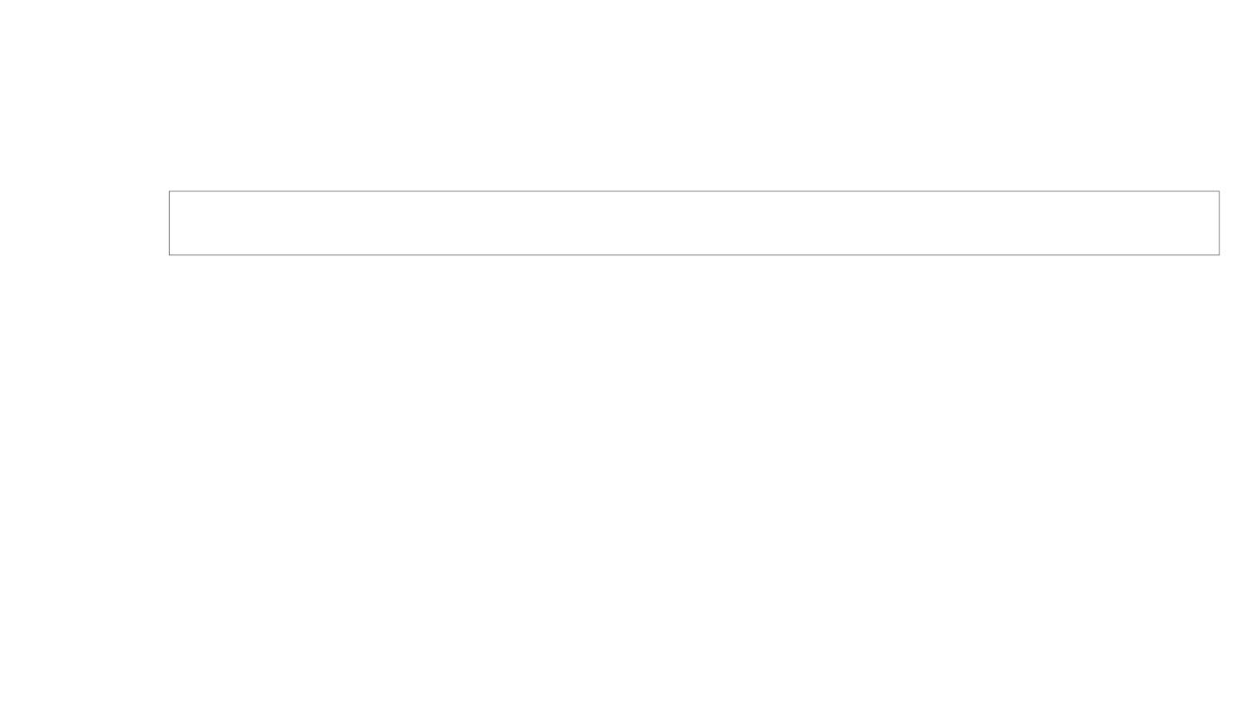
Reading data using pandas
In [ ]:#Read csv file
df = pd.read_csv("http://rcs.bu.edu/examples/python/data_analysis/Salaries.csv")
Note: The above command has many optional arguments to fine-tune the data import
process.
There is a number of pandas commands to read other data formats:
pd.read_excel('myfile.xlsx',sheet_name='Sheet1', index_col=None,
na_values=['NA'])
pd.read_stata('myfile.dta')
pd.read_sas('myfile.sas7bdat')
pd.read_hdf('myfile.h5','df')
18

Slide 138
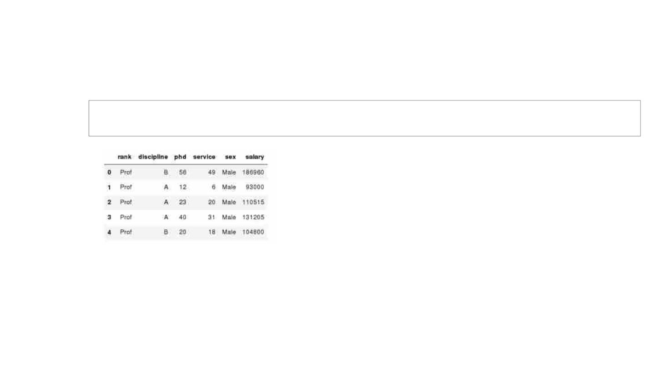
Exploring data frames
In [3]:#List first 5 records
df.head()
Out[3]:
19

Slide 139
8.2 Introduction to Numpy

Slide 140
Numpy is a python package.
It stands for 'numerical python’.
It is a library consisting of multidimensional array objects and a collection of routines for processing of array.
Numeric, the ancestor of numpy, was developed by Jim Hugunin.
Another package numarray was also developed, having some additional functionalities.

Slide 141
In 2005, Travis Oliphant created Numpy package by incorporating the features of Numarray into numeric package. There are many contributors to this open source project.

Slide 142
OPERATIONS USING NUMPY
using numpy, a developer can perform the following operations − mathematical and logical operations on arrays.
Fourier transforms and routines for shape manipulation.

Slide 143
INSTALLATION
If you installed python(x,y) on a windows platform, then you should be ready to go.
If not, then you will have to install numpy manually after installing python,
Installation files are available for both at: http://www.numpy.org/

Slide 144
IMPORTING THE NUMPY MODULE
There are several ways to import NumPy.
The standard approach is to use a simple import statement:
>>> import numpy
However, for large amounts of calls to NumPy functions, it can become tedious to write numpy.x over and over again. Instead, it is common to import under the briefer name np:
>>> import numpy as np

Slide 145
OTHER RESOURCES
Documentation and Resources
The NumPy and SciPy development community maintains an extensive online documentation system, including user guides and tutorials, at: http://docs.scipy.org/doc/

Slide 146
9.1 HIGH DIMENSIONAL ARRAY

Slide 147
Python has a data type known as a list. For our purposes, lists are arrays. Arrays are called as Lists in python
Declaration syntax: <name> = [<value>, <value>, <value>, …, <value>]
<name> = [<default value>] * <initial array size>
Example: numbers = [12, 49, -2, 26, 5, 17, -6]
zeros = [0] * 10
Indexing: Lists have zero based indexing from front
Negative Indexing: You can also refer to an element by a negative index representing how far it is from the end.
Example: index from front 0 1 2 3 4 5
numbers = [ 13, 25, 39, 46, 54, 68]
index from back -6 -5 -4 -3
-2 -1

Slide 148
Like a String, list also is sequence data type. It is an ordered set of values enclosed in square brackets [].
Values in the list can be modified, i.e. it is mutable. As it is set of values, we can use index in square brackets [] to identify a value belonging to it.
The values that make up a list are called its elements, and they can be of any type.

Slide 149
We can also say that list data type is a container that holds a number of elements in a given order. For accessing an element of the list, indexing is used.
Syntax is :
Variable name [index]
It will provide the value at „index+1‟ in the list. Index here, has to be an integer value which can be positive or negative.

Slide 150



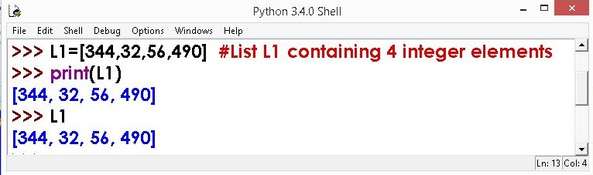

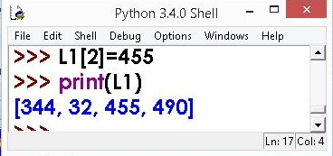
LISTS EXAMPLE
3rd Element of list modified.

Slide 151

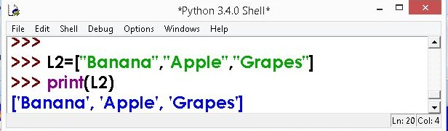

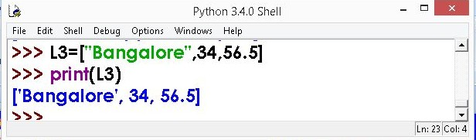
LISTS EXAMPLE
List containing string type data
List containing mixed data

Slide 152

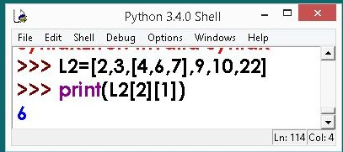
LISTS EXAMPLE
Use double subscript to fetch the sub list in a given list.
Similarly, L2[2][0] will fetch you 4 value L2[2][2] will fetch you 7 value.

Slide 153
WORKING WITH LIST INDEX
List index works the same way as String index, which is:
✔An integer value/expression can be used as index.
✔An Index Error appears, if you try and access element that does not exist in the list.
✔An index can have a negative value, in that case counting happens from the end of the list.

Slide 154

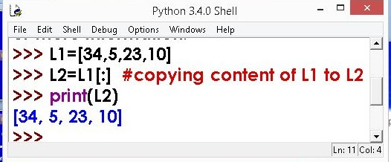
LIST - Example

Slide 155
9.2 HIGH DIMENSIONAL ARRAY

Slide 156
Deleting Elements of LIST
It is possible to delete/remove element(s) from the list. There are many ways of doing so:
If index is known, we can use pop ( ) or del
If the element is known, not the index, remove ( ) can be used.
To remove more than one element, del ( ) with list slice can be used.
Using assignment operator

Slide 157





Deleting Elements of LIST
1. pop ( ) Method
2. del Method
3. remove ( ) Method

Slide 158

Deleting Elements of LIST
1. pop ( ) Method
It removes the element
from the return the
specified index, and also
element which was removed. Its syntax is:
List.pop ([index])

Slide 159



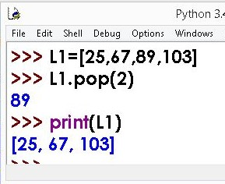
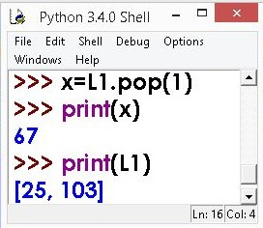
Deleting Elements of LIST
1. pop ( ) Method
For Example:
Popped element 67 is assigned to x

Slide 160


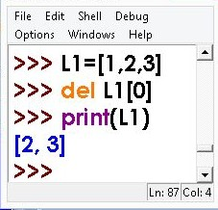




Deleting Elements of LIST
2. del Method
del removes the specified element from the list, but does not return the deleted value.
Syntax :
del Listobject[index]
del method example

Slide 161

Deleting Elements of LIST
3. remove ( ) Method
In case, we know the element to be deleted not the index, of the element, then remove () can be used.
Syntax is:
listobject.remove(value)
>>>L1.remove(60)

Slide 162



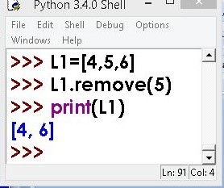
Deleting Elements of LIST
3. remove ( ) Method

Slide 163
THANK U

